Slide 1
Banking Application
By,
SHALINI K

Slide 2
CONTENT
Abstract
Scope
Requirements
Modules Output Conclusion

Slide 3
ABSTRACT
The main aim of Banking System Project is to maintain database of customers. In this project developed in Java programming language using mysql database.
This project will help to insert the every details of the customers that will stored in database.
This project will help to update records of customers If customers made any change in their records.
This project helps banking system to find the particular record of the customer and also they can see their balance of
customers

Slide 4
SCOPE
Without a banking application, managing and maintaining the details of the customer is a difficult job for banks.
Banking application System will store all the details of the customer such ,name, account no, branch,phone no, balance of the cutomers.

Slide 5
REQUIREMENTS
SOFTWARE REQUIREMENTS
Operating System - Windows
Platform - Eclipse IDE
Language - Core Java 8
Database – Ms sql server, Mysql
HARDWARE REQUIREMENTS
SERVER-: Processor - Intel Core Family,
RAM - 8 GB
Disk Space - 500 MB or more

Slide 6
MODULES
Insert record Select record
Update record Delete record Withdraw amount
Deposit amount

Slide 7
INSERT RECORD
The insert record module is used to inserting the record of the customer.
Like name, branch,phone number of the that will be stored in database.

Slide 8
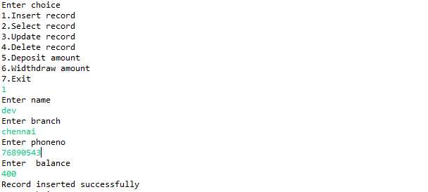
INSERT MODULE

Slide 9
SELECT RECORD
.
The select record method is used to select the information of a particular customer by entering account number
By entering the roll number the customer can view their details of name, account number,branch,phone number, balance.

Slide 10
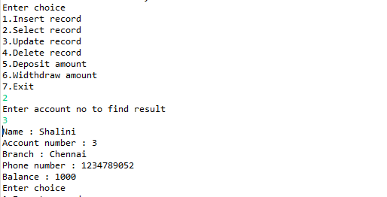
SELECT MODULE

Slide 11
UPDATE RECORD
The Update Record method is used for updating the name, branch, phone number of customer if they want to update their details.

Slide 12
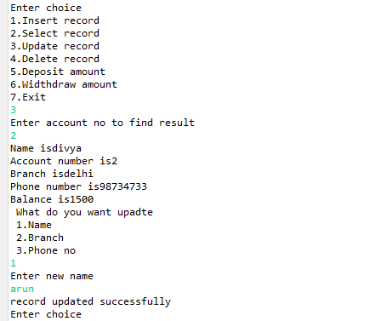
UPDATE MODULE

Slide 13
DELETE RECORD
The Delete Record method is used to delete the details of the customer record.
By entering the account number we can delete the particular record of the customer if needed.

Slide 14
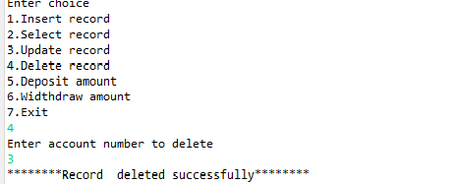
DELETE MODULE

Slide 15
DEPOSIT AMOUNT
The Deposit Record method is used to deposit the amount in the customers account.
By using the account number to deposit money in the particular account. It will show the current balance after deposit it will show available balance.

Slide 16
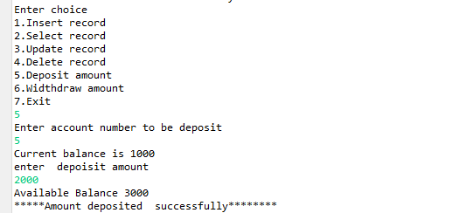
DEPOSIT AMOUNT

Slide 17
WITHDRAW AMOUNT
The withdraw amount method is used to withdraw amount from customer account.
By using the account number we can deposit amount in the particular account.It shows current balance after withdrawl it shows available balance of the customer.

Slide 18
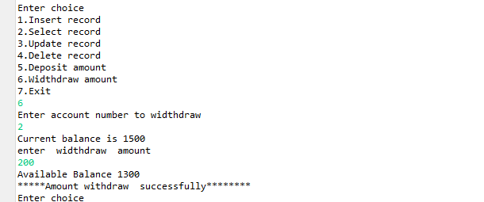
WITHDRAW AMOUNT

Slide 19
Conclusion
Banking application can be used by the administrators to maintain the customers records easily.
The result of this project will be accurate and totally error free.
The growing use of internet and computers confirms the good scopes of project.

Slide 20
Thank you

